Slide 1

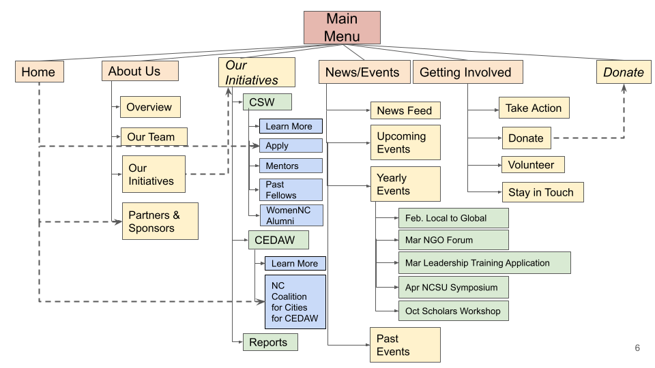
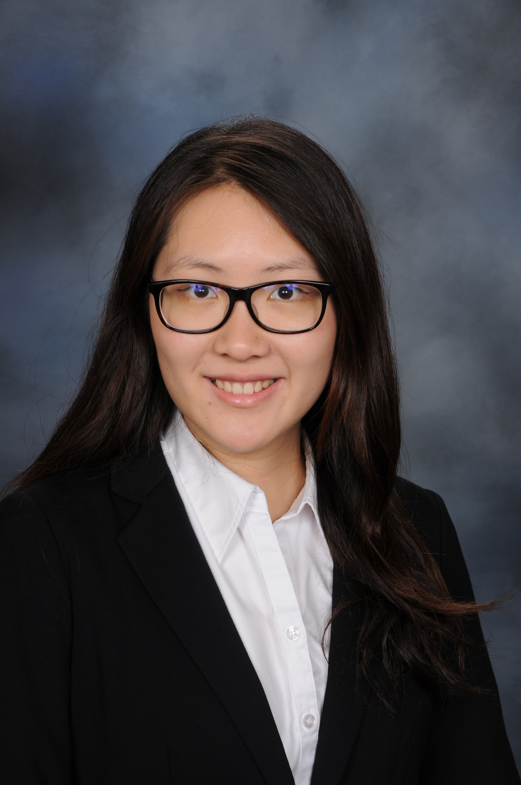
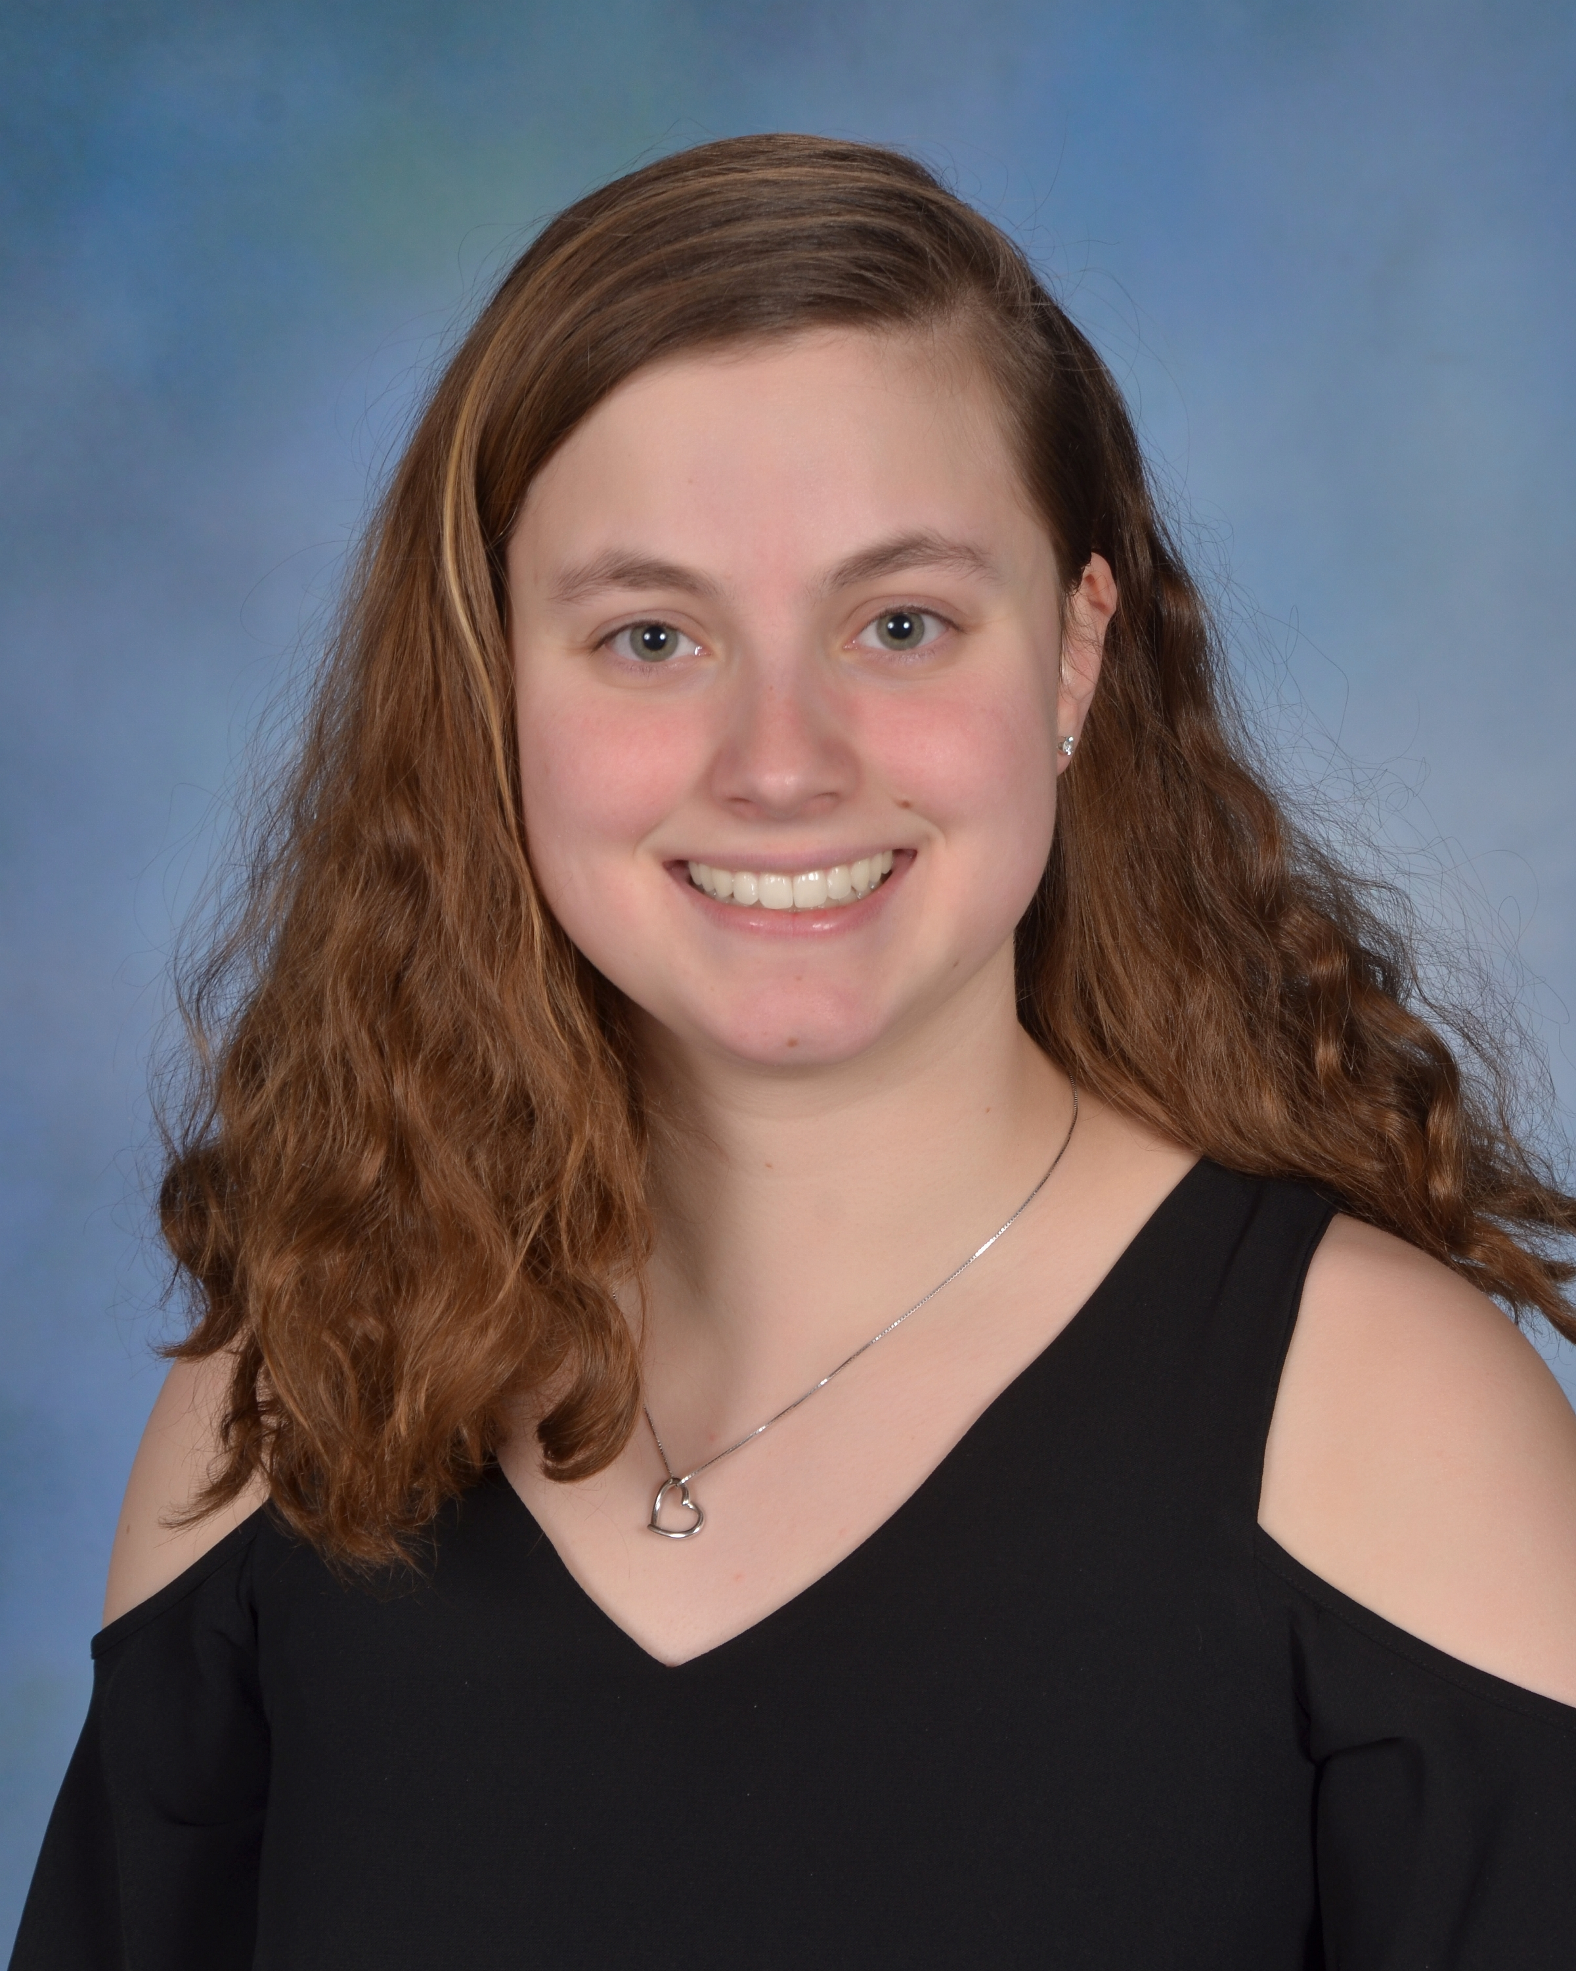
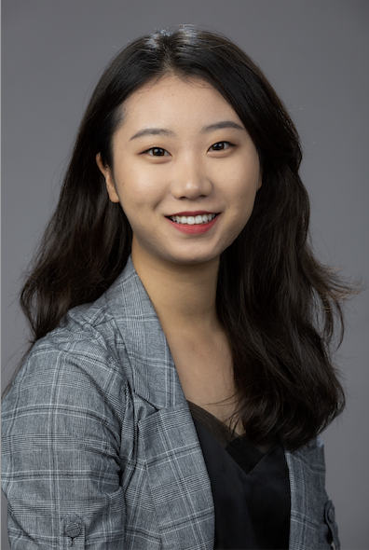
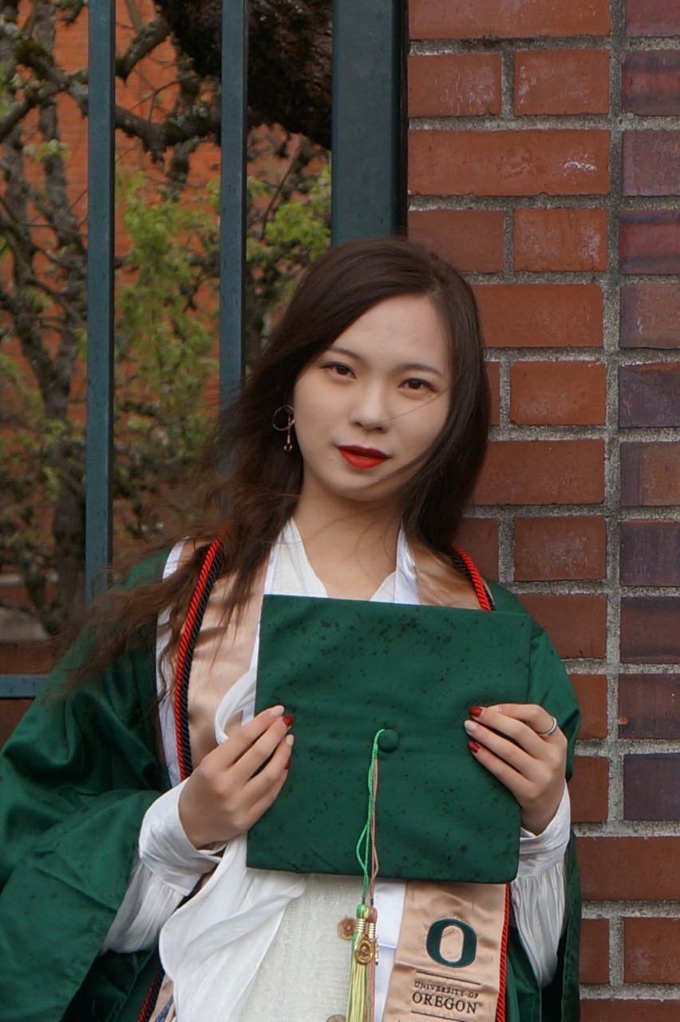
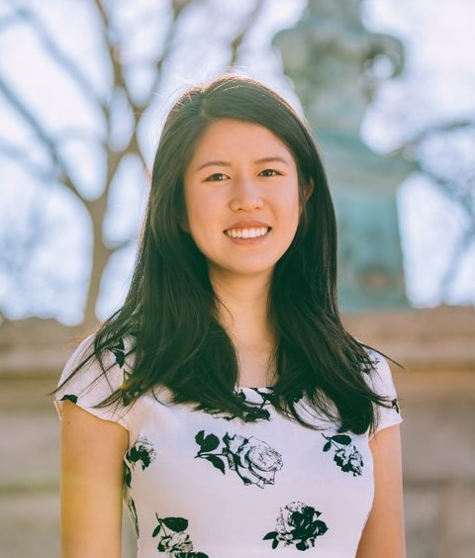
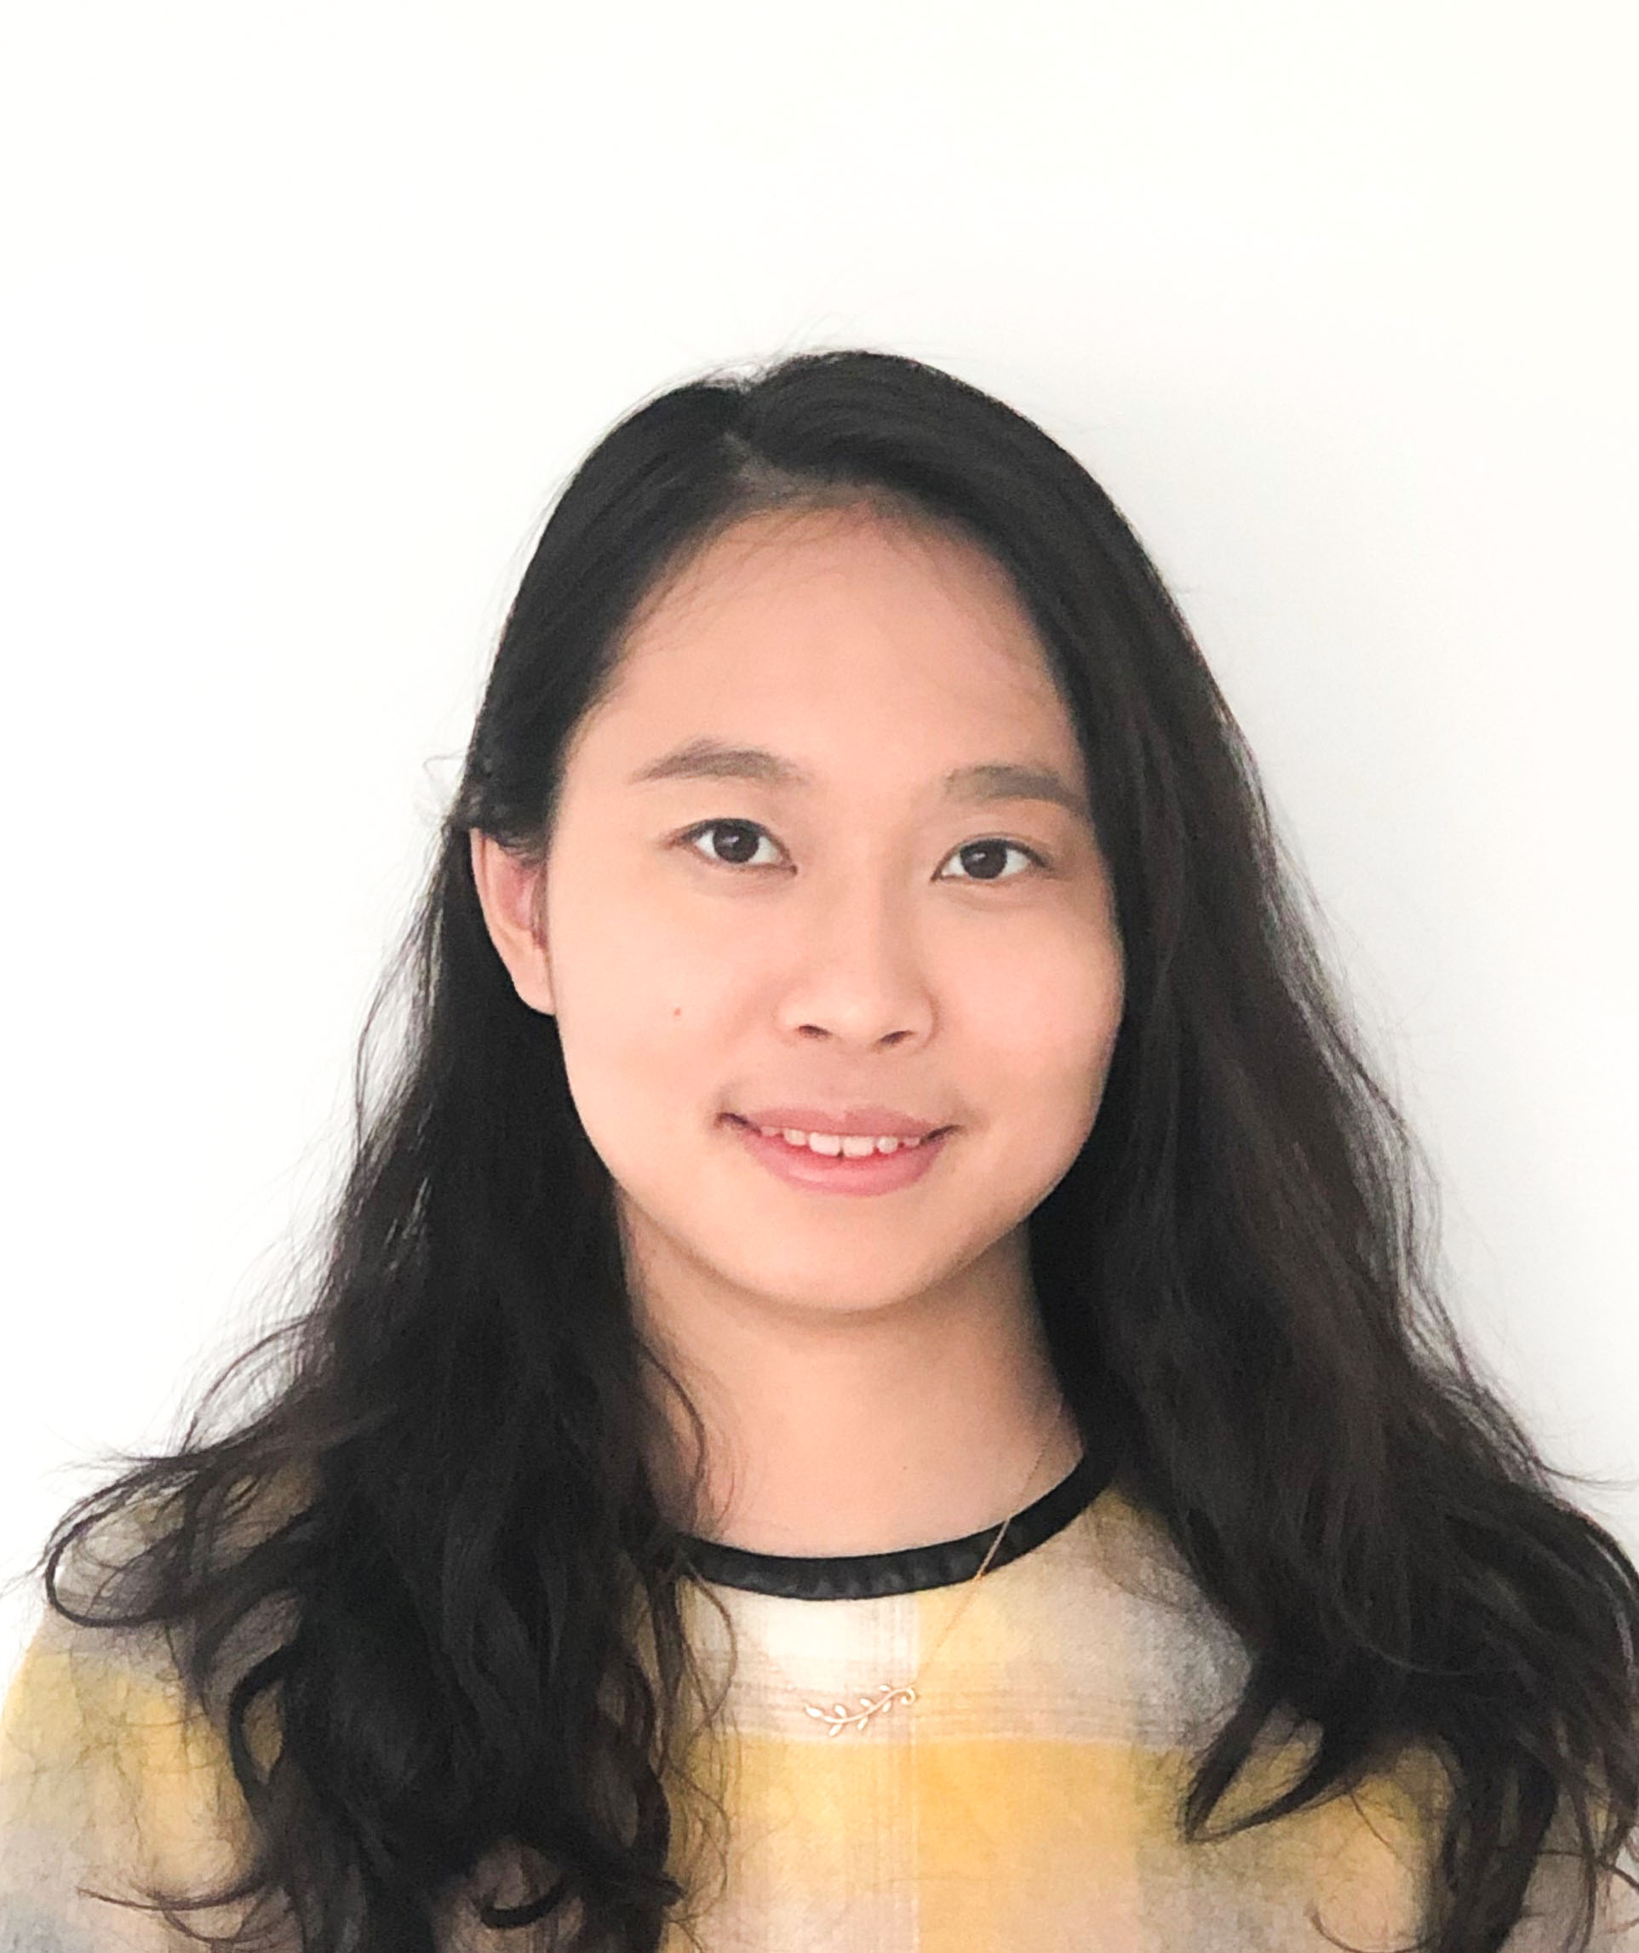
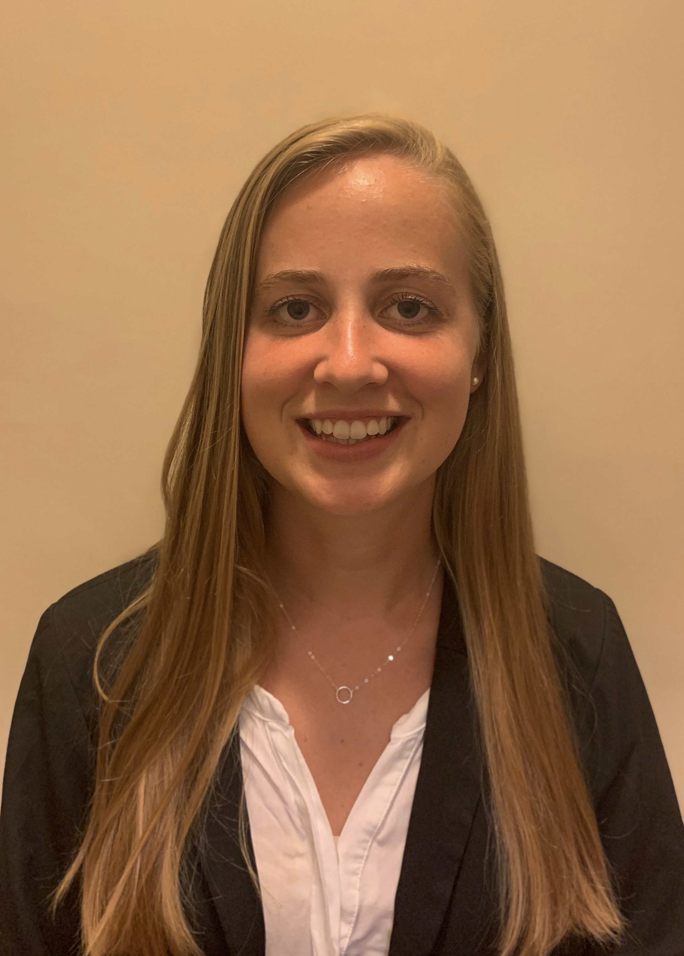
New WomenNC Website Map
Results
We created two versions of a content map that matched WomenNC's goals and visitor goals, respectively. After researching and interviewing a global health expert and WomenNC’s web designer, we redesigned the website menu using a tree diagram and illustrated ideas for web design using examples from comparative websites. We also redesigned the footer of each website page to reflect WomenNC's priorities.
About Women NC
Who we are:
Women NC is a non-profit organization with a mission to empower the next generation to advance gender equality in North Carolina. Our vision is to create a world free of gender discrimination.
What we do:
We have two distinguished initiatives:
Commission on the Status of Women Leadership Training Program
Convention on the Elimination of Discrimination Against Women
Future Directions
The next recommended steps to implement the new website content map and menus are:
Archive older content from current website.
Re-format main menu tabs and create new menu pages according to new content map.
Draft new website text for “About Us,” “Our Initiatives,” and “Getting Involved” pages.
Gather photos and quotes from current and past Scholars to include on the website.
Aim to organize page content and design into color blocks, scrolling galleries, and large buttons for accessibility.
Create new “Volunteer” and “Contact Us” sign-up forms (i.e. GoogleForms embedded)
Project Goal
This semester’s goal was to take inventory of WomenNC’s current website content and re-design the website to better reflect WomenNC’s mission, goals, and initiatives.
Meet the DISI WomenNC Team
Acknowledgements
From WomenNC, we would like to acknowledge the help we received from the WomenNC board for providing us with valuable feedback and professional opinions.
We would also like to thank the global health expert and web designer for taking the time to meet with us and provide useful insight!
Finally, we would like to thank the DISI executive board for giving us the opportunity to contribute to local nonprofit organizations.
Objectives
Meet with WomenNC board members to determine what content is needed for the websites and to gain insight into how they would like to organize the site.
Create a content map to assist in the organization of the new website
Raven Luo
Brittany Smith
Hanling Su
Zhenyi Guo
Claire Huang
Jasmine Yao
Kiernan Spencer

